Slide 1


Computer Applications to Behavioral Sciences
Introduction to Python
何吉波，博士
清华大学用户体验学科负责人
优视眼动科技公司创始人
http://www.usee.tech

Slide 2
Course Syllabus
Syllabus for Psychology 568 – Computer Applications to the Behavioral Sciences
https://psychology-courses.appspot.com/python/assets/img/2014%20Fall%20-%20PSY%20568%20Python%20for%20Behavioral%20Scientist.doc

Slide 3
Lecture information
任课老师 | 联系方式 | 助教 | 办公地点
何吉波 | hejibo@usee.tech | 冯博 刘明春 马天云 | 清华大学伟清楼304
Course Goal:
This course is designed for undergraduate and graduate students and behavioral scientists, who hope to improve their research skills, such as read and write files, statistics, graphing, and experiment implementation. This course also suits students who specialize in computer science or students who have not had any programming language but wish to learn programming easily.

Slide 4
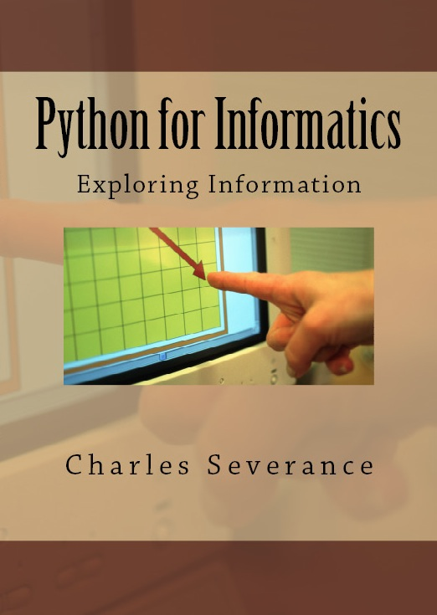
Textbook
Downey, A. (2008). Think Python: An introduction to software design. Needham, MA: Green Tea Press.
Severance, C. (2013).
Python for Informatics: Exploring Information. CreateSpace Independent Publishing Platform; 1 edition
- FREE digital version
- also available for iBook, iPad, iPhone and Kindle

Slide 5
Course Requirement
The grades will include actually three parts.
1. Four homework - 40%, each 10%. You will have four homework; each counts 10% of the total score.
2. Semester project - 50%. You will finish a large project across the semester. It can be a project your advisor or boss hopes you to do or you are interested, such as create a personal website, data analysis for an experiment, a program you want to develop. You can get most of the score for the semester project if your project requirement is met at the end of the semester.
3. Presentation - 10%. You need to give a presentation about your semester project near the end of the semester.
4. No Final Exam! - Yeah.

Slide 6
Why should I learn programming?
Make your work more efficient
Be Creative
Survival skills for research
Help you get a good job

Slide 7
Why be a programmer?
To get some task done - we are the user and programmer
Clean up survey data
To produce something for others to use - a programming job
Fix a performance problem in the Sakai software
Add guestbook to a web site

Slide 8
What is Code? Software? A Program?
A sequence of stored instructions
It is a little piece of our intelligence in the computer
It is a little piece of our intelligence we can give to others - we figure something out and then we encode it and then give it to someone else to save them the time and energy of figuring it out
A piece of creative art - particularly when we do a good job on user experience

Slide 9
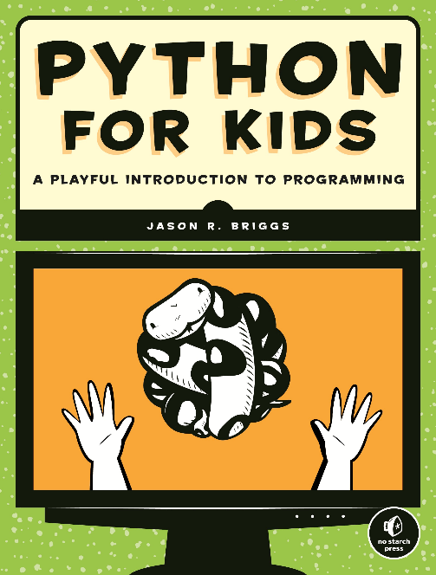
Why should I learn Python?
Easy to learn
Fast to program
Clear Syntax
Battery included
Cross platform

Slide 10
What can Python do?
Build a website
Develop a software
Draw publishable graphs
Statistical analysis
Text processing

Slide 11
Python vs. JAVA
HelloWorld.java
public class HelloWorld {
public static void main(String[] args) {
System.out.println("Hello, World");
}
}
HelloWorld.py
print(“Hello, World”)

Slide 12
Python vs. C
HelloWorld.c
#include<stdio.h>
main() {
printf("Hello World");
}
HelloWorld.py
print(“Hello, World”)

Slide 13
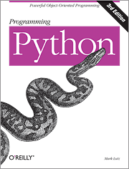
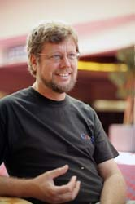

Python as a Language
Python is the language of the Python Interpreter and those who can converse with it. An individual who can speak Python is known as a Pythonista. It is a very uncommon skill, and may be hereditary. Nearly all known Pythonistas use software initially developed by Guido van Rossum.

Slide 14
Install Python
Search “Python 3.3 download”
Windows
https://www.python.org/download/releases/2.7.3/
Windows x86 MSI Installer (2.7.3) (sig) Windows X86-64 MSI Installer (2.7.3) [1] (sig)
Linux
Python is installed already
Mac
Python 2.7.8 Mac OS X 64-bit/32-bit x86-64/i386 Installer (for Mac OS X 10.6 and later [2]) Python 2.7.8 Mac OS X 32-bit i386/PPC Installer (for Mac OS X 10.3 and later [2])

Slide 15
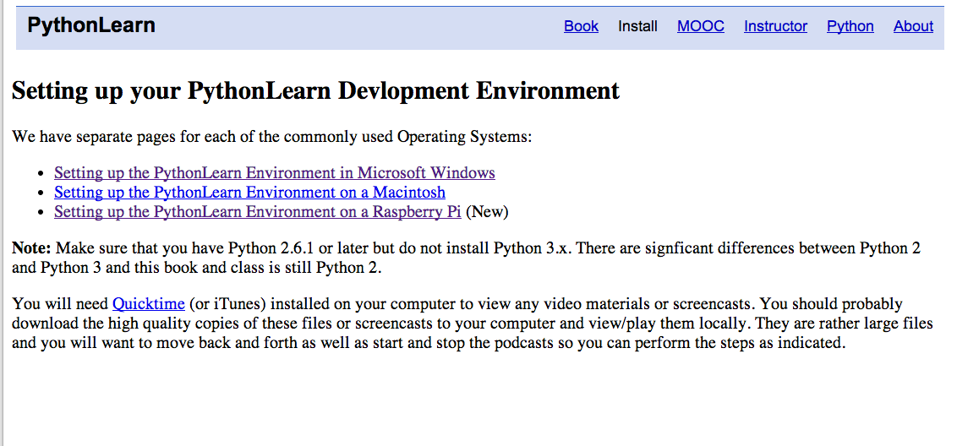
http://www.pythonlearn.com/install.php

Slide 16
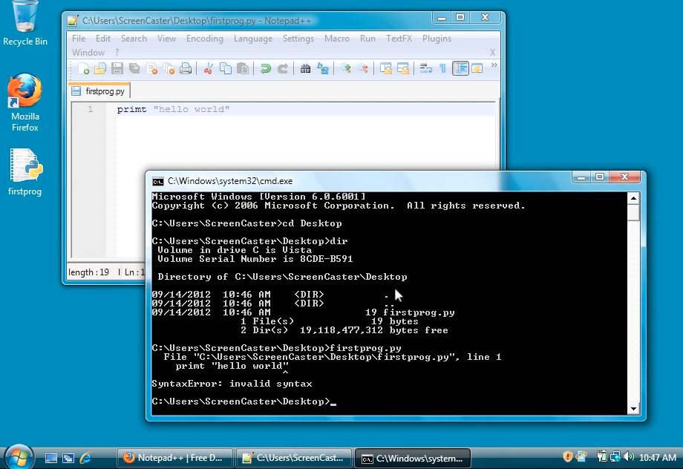
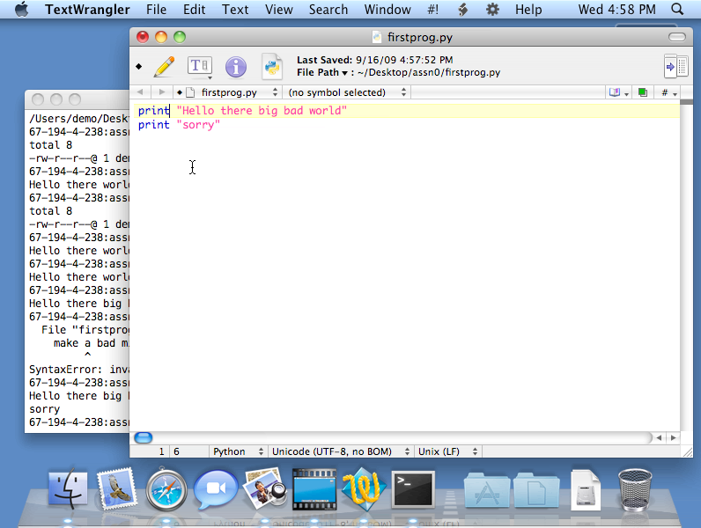
http://www.pythonlearn.com/install.php

Slide 17

“Hello World” in Python

Slide 18
“Hello World” in Python
csev$ python
Python 2.5 (r25:51918, Sep 19 2006, 08:49:13)
[GCC 4.0.1 (Apple Computer, Inc. build 5341)] on darwin
Type "help", "copyright", "credits" or "license" for more information.
>>>
What next?

Slide 19
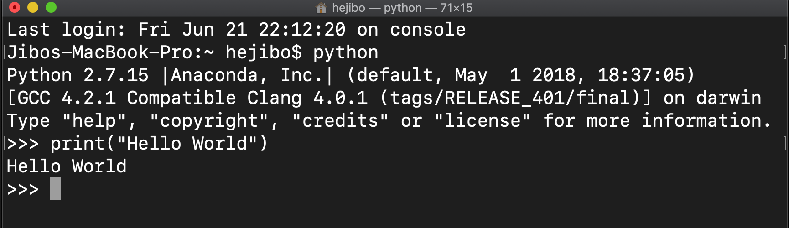
“Hello World” in Python

Slide 20
Integrated Development Environments (IDE)
List of IDEs
https://wiki.python.org/moin/IntegratedDevelopmentEnvironments
Recommended IDEs
Eclipse
PyCharm
PyScripter
Spyder - MATLAB style
Visual Studio Code
Anaconda

Slide 21
csev$ python
Python 2.5 (r25:51918, Sep 19 2006, 08:49:13)
[GCC 4.0.1 (Apple Computer, Inc. build 5341)] on darwin
Type "help", "copyright", "credits" or "license" for more information.
>>> x = 1
>>> print(x)
1
>>> x = x + 1
>>> print(x)
2
>>> exit()
This is a good test to make sure that you have Python correctly installed. Note that quit() also works to end the interactive session.

Slide 22
Elements of Python
Vocabulary / Words - Variables and Reserved words (Chapter 2)
Sentence structure - valid syntax patterns (Chapters 3-5)
Story structure - constructing a program for a purpose

Slide 23
Reserved Words
You can not use reserved words as variable names / identifiers
and del for is raise assert elif from lambda return break else global not try class except if or while continue exec import pass yield def ﬁnally in print

Slide 24
Sentences or Lines
x = 2
x = x + 2
print(x)
Assignment Statement
Assignment with expression
Print statement
Variable
Operator
Constant
Reserved Word

Slide 25
Programming Paragraphs
Interactive Python is good for experiments and programs of 3-4 lines long
But most programs are much longer so we type them into a file and tell python to run the commands in the file.
In a sense we are “giving Python a script”
As convention, we add “.py” as the suffix on the end of these files to indicate they contain Python
Python Scripts

Slide 26
Interactive versus Script
Interactive
You type directly to Python one line at a time and it responds
Script
You enter a sequence of statements (lines) into a file using a text editor and tell Python to execut the statements in the file

Slide 27
x = 1
Program:
x = 2
print(x)
x = x + 2
print(x)
print(x)
Output:
24
x = x + 1
Sequential Steps
print(x)
When a program is running, it flows from one step to the next. We as programmers set up “paths” for the program to follow.
Chapter 2

Slide 28
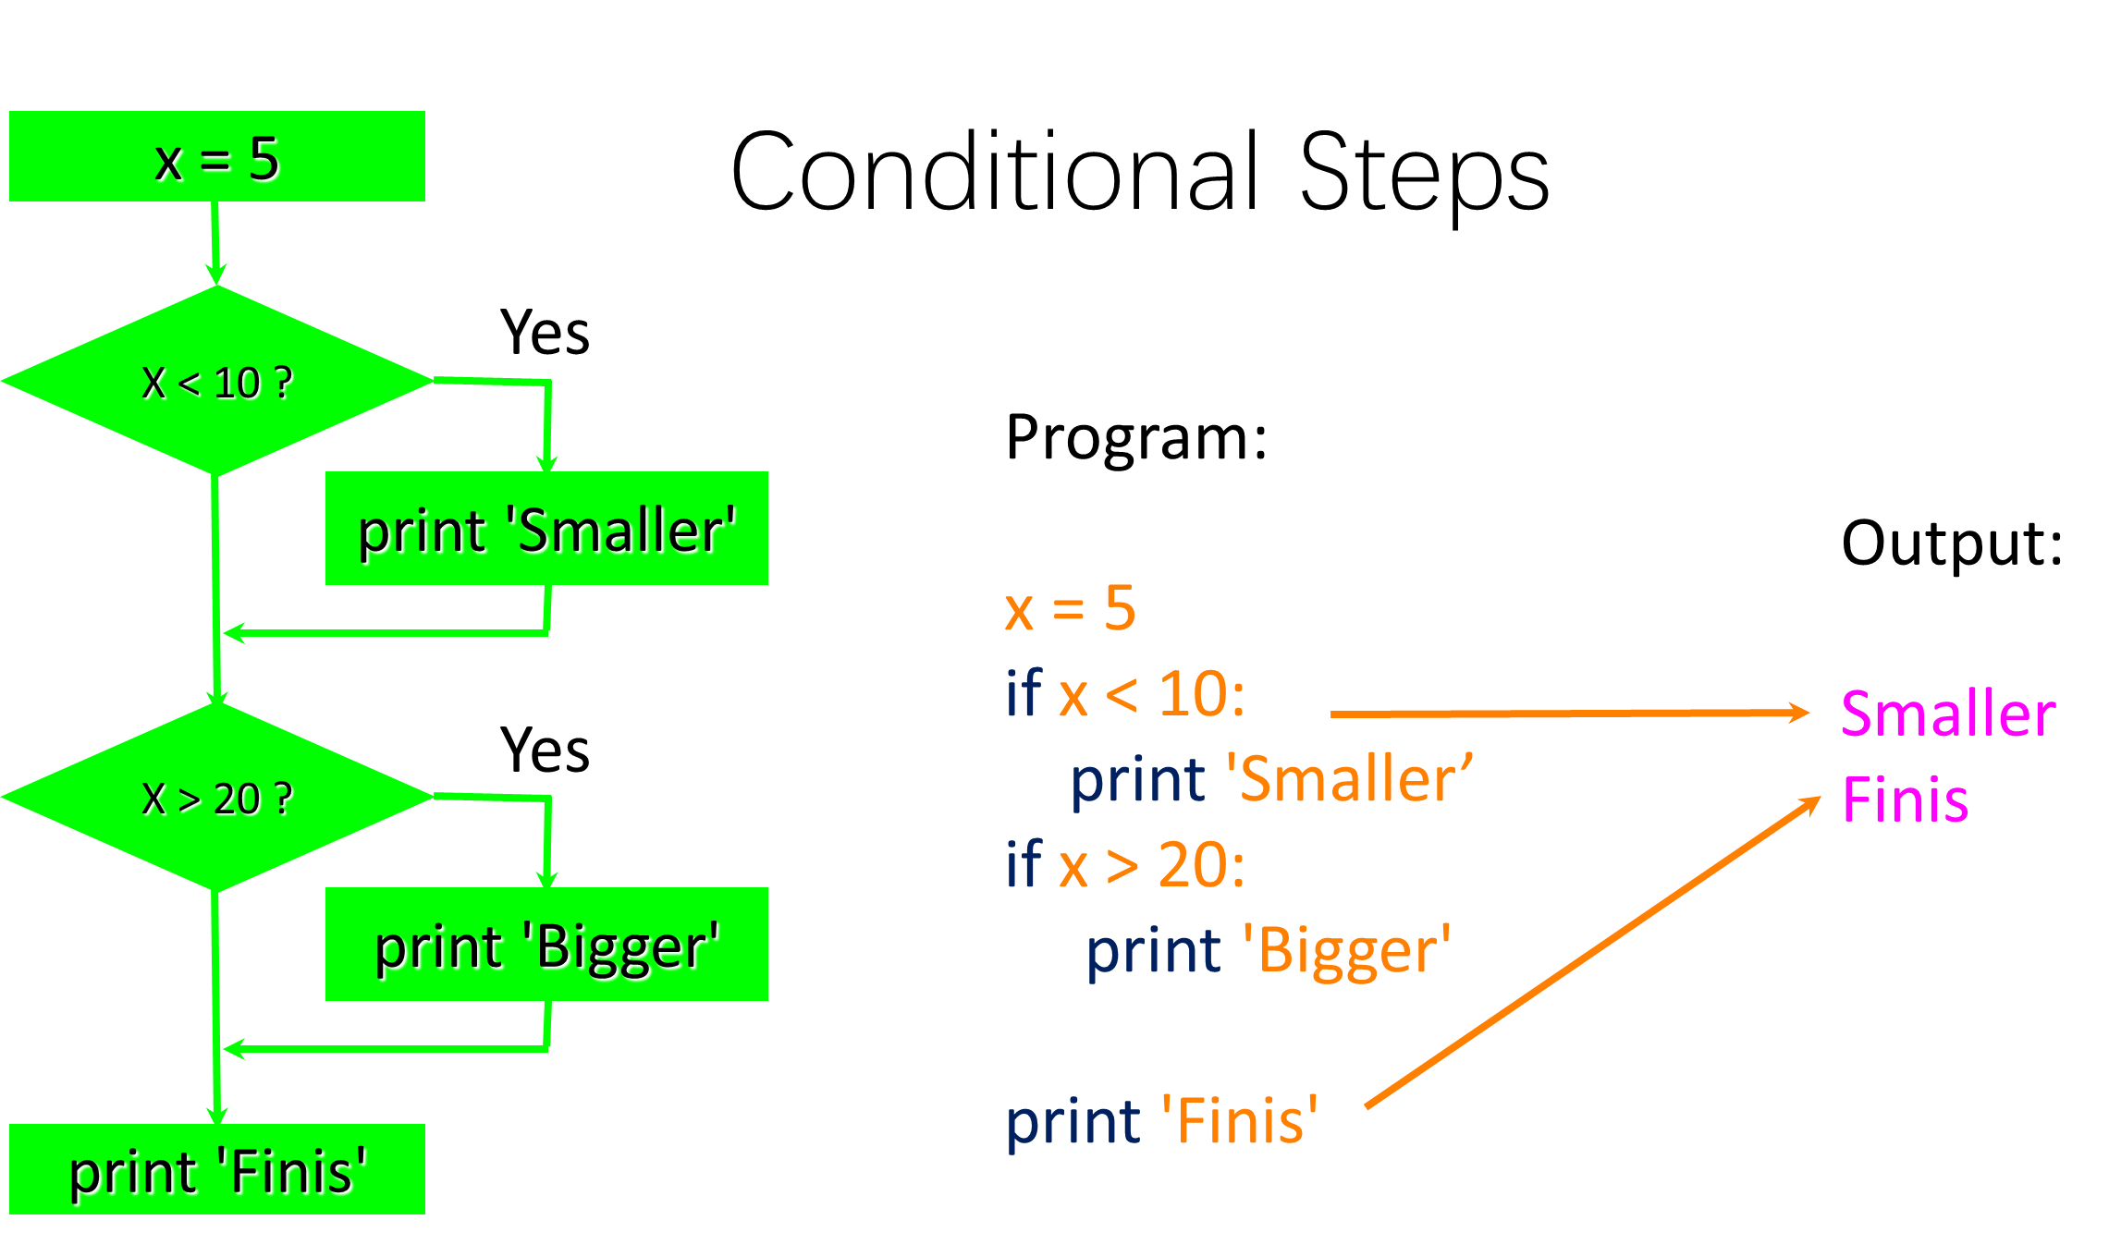

Slide 29
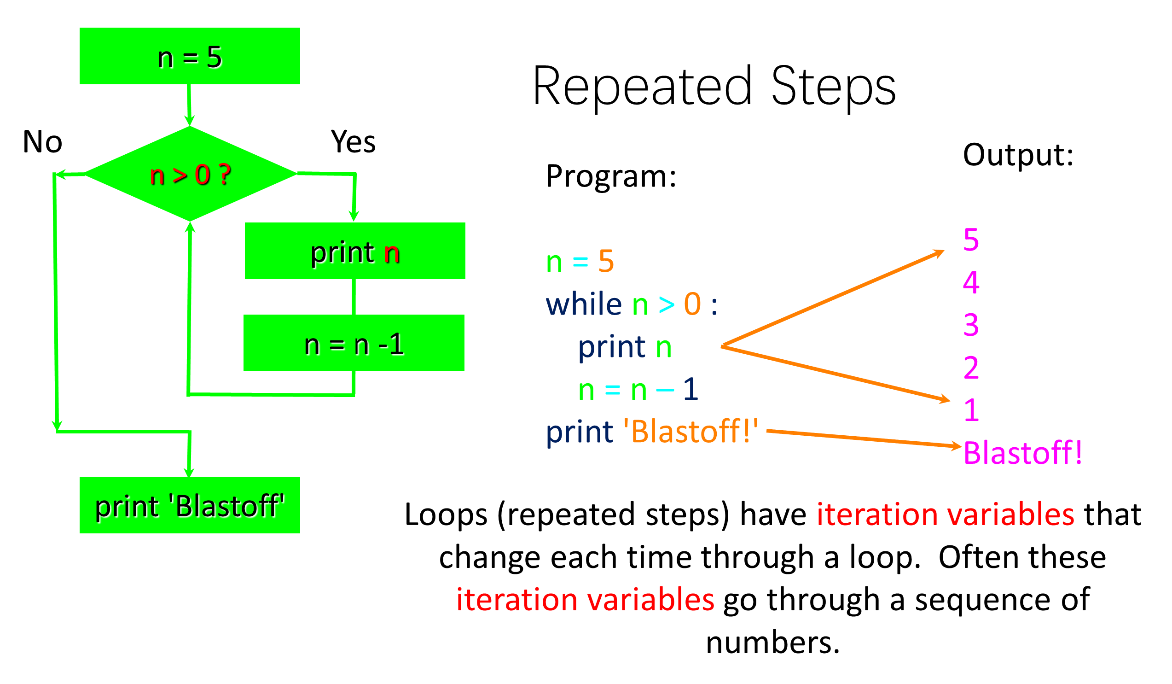

Slide 31
Summary
This is a quick overview of Chapter 1
We will revisit these concepts throughout the course
Focus on the big picture

Slide 32



人因交互和用户体验研究中心
地址：清华大学伟清楼304
邮箱：hejibo666@mail.tsinghua.edu.cn
微信号：hejiboqinghua
手机号：13051381327
微博

